Slide 1



Taxi service cab data insights
View in Power BI
Last data refresh:
12/23/2024 8:55:33 AM UTC
Downloaded at:
12/23/2024 9:18:26 AM UTC

Slide 2
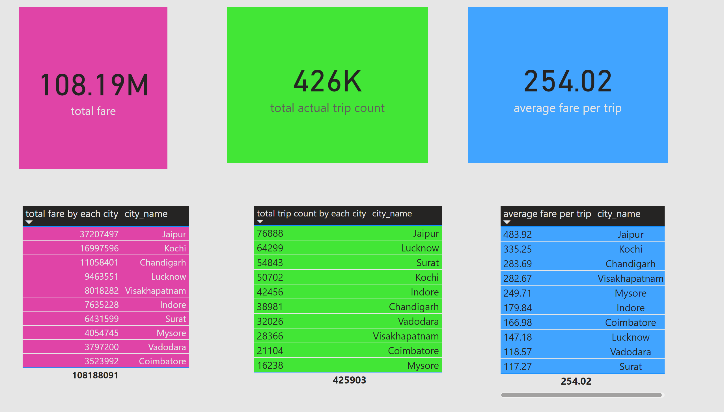
AVERAGE FARE PER TRIP BY CITY
Notes:
tableEx
No alt text provided
tableEx
No alt text provided
tableEx
No alt text provided
card
No alt text provided
card
No alt text provided
card
No alt text provided

Slide 3
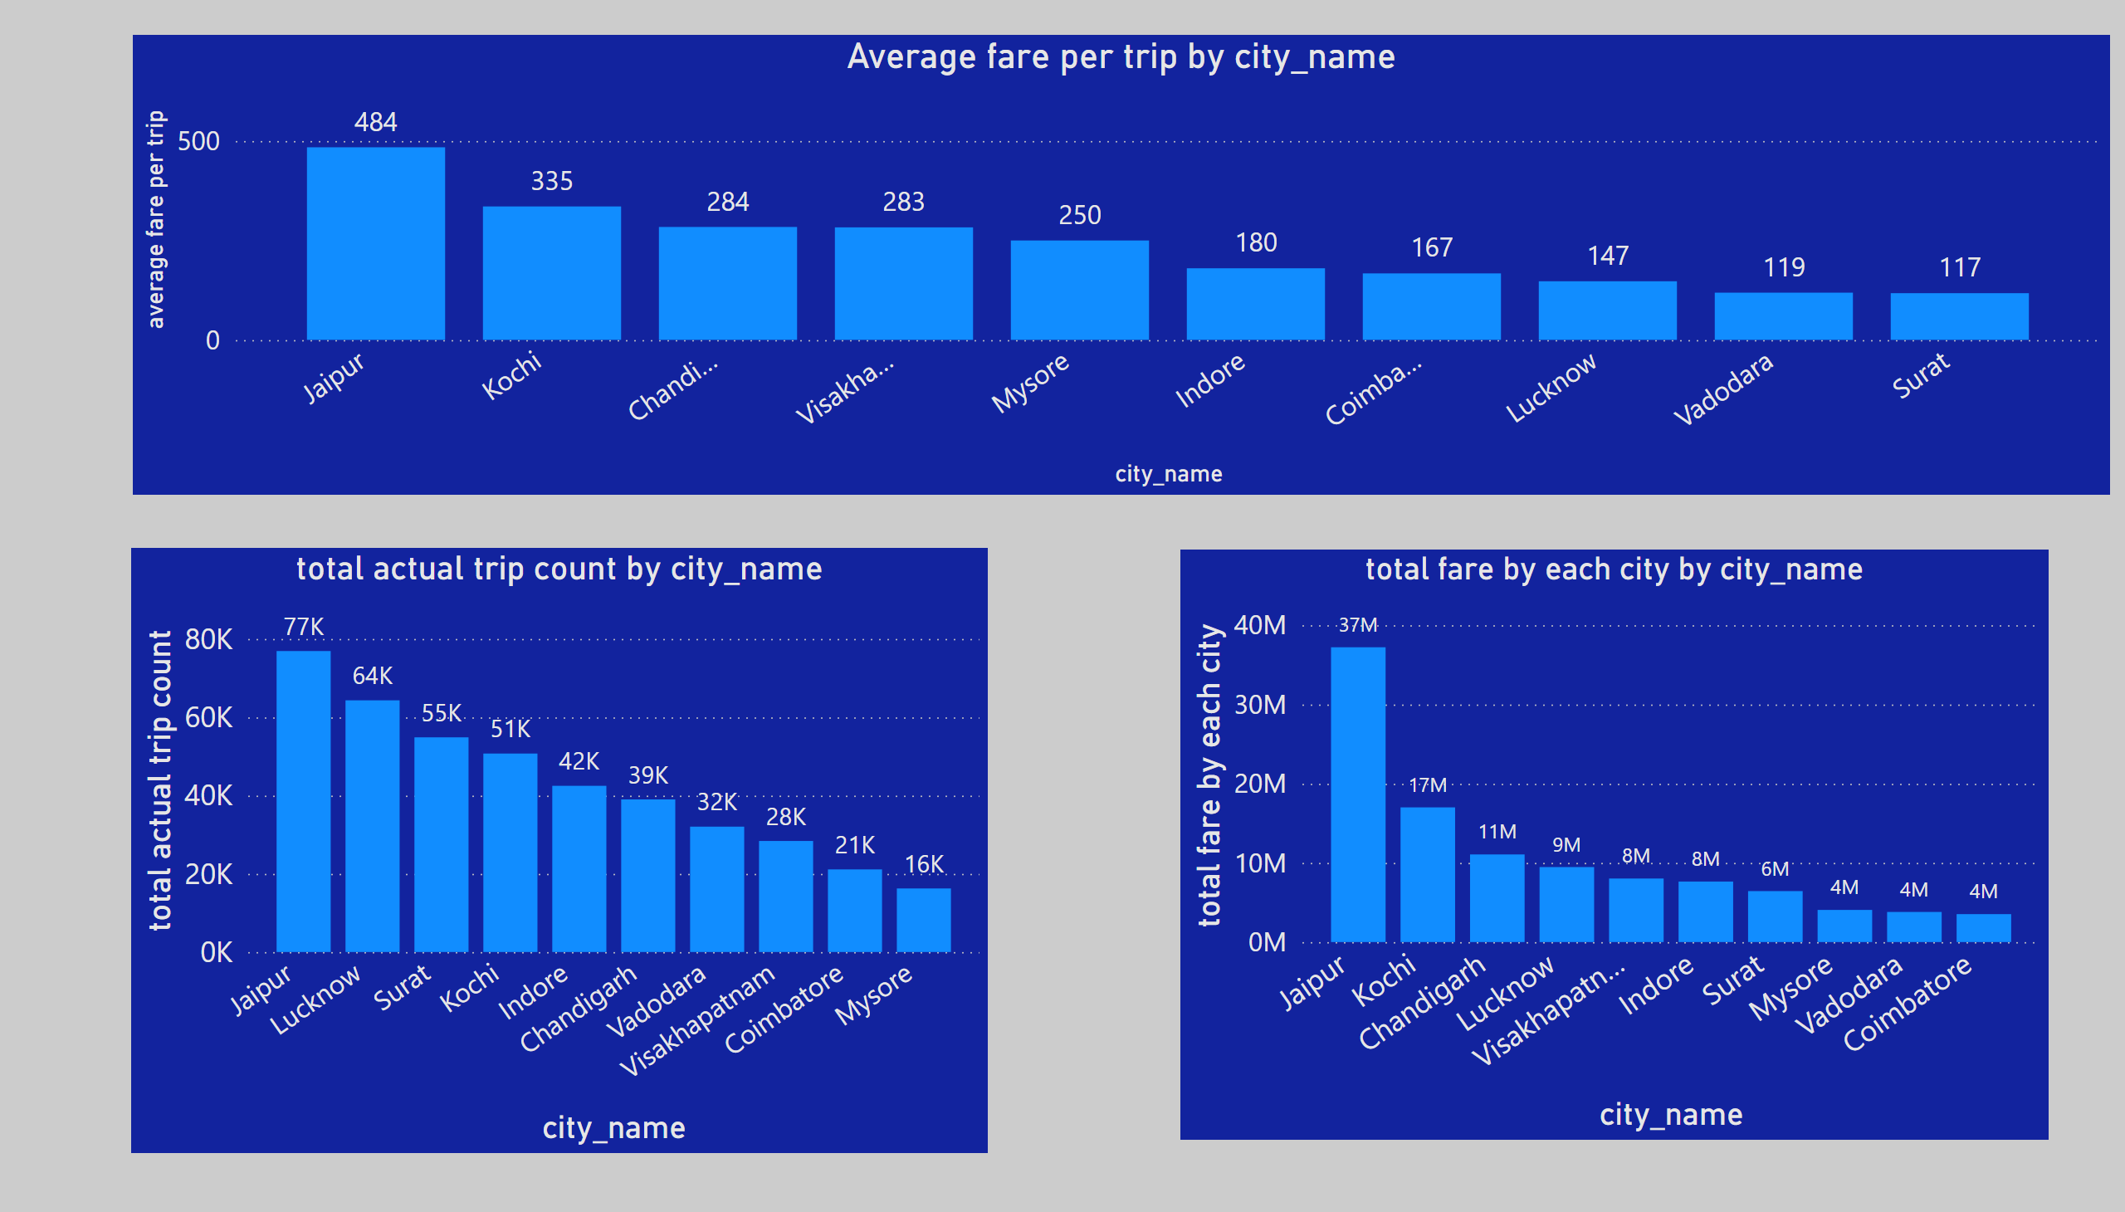
AVERAGE FARE PER TRIP BY CITY
Notes:
Average fare per trip by city_name
No alt text provided
clusteredColumnChart
No alt text provided
clusteredColumnChart
No alt text provided

Slide 4
MARKET DEMAND IN EACH CITY
What It Tells
Market Demand:Higher trip counts in a city signify higher demand for taxi services, indicating a potentially market.
Lower trip counts may indicate low demand
What to Do Where Trip Count Is Less
Investigate the Root Cause:
Demographics: Study the population size and socio-economic status of the city. Smaller cities or those with lower incomes may have less demand.
Competition: Evaluate if competitors dominate the market.
Awareness: Assess if potential customers are aware of the service.
Service Quality: Check reviews or complaints for potential service-related issues.
Targeted Marketing:
Run localized marketing campaigns to raise awareness.
Offer promotions, discounts, or loyalty programs.
Optimize Operations:
Adjust the fleet size to reduce operational costs in low-demand areas.
Explore partnerships with local businesses or events to boost demand.
Expand Services:
Introduce value-added services like ride-sharing or corporate tie-ups.
Offer options like luxury cabs, electric vehicles, or bike taxis based on the city's specific needs.

Slide 5
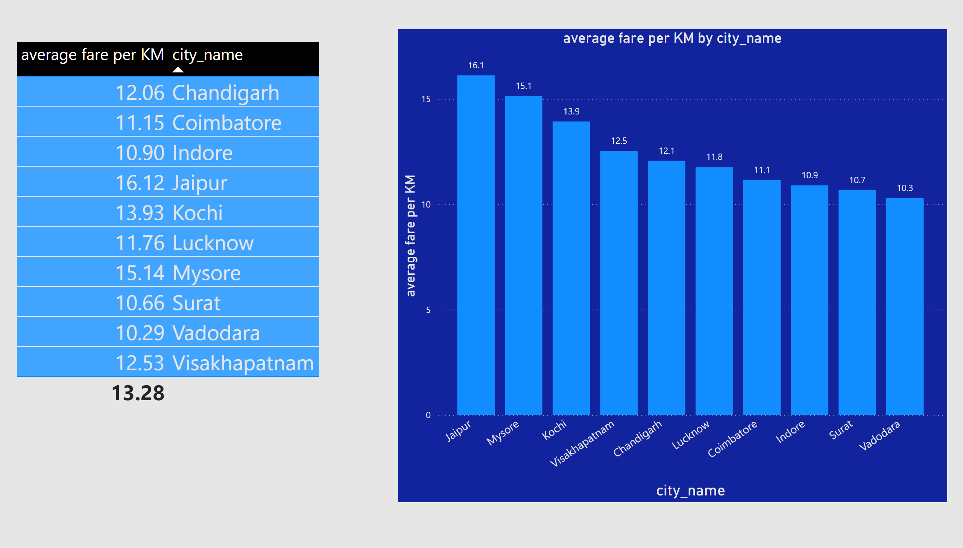
AVERAGE FARE PER KM BY CITY
Notes:
tableEx
No alt text provided
clusteredColumnChart
No alt text provided

Slide 6
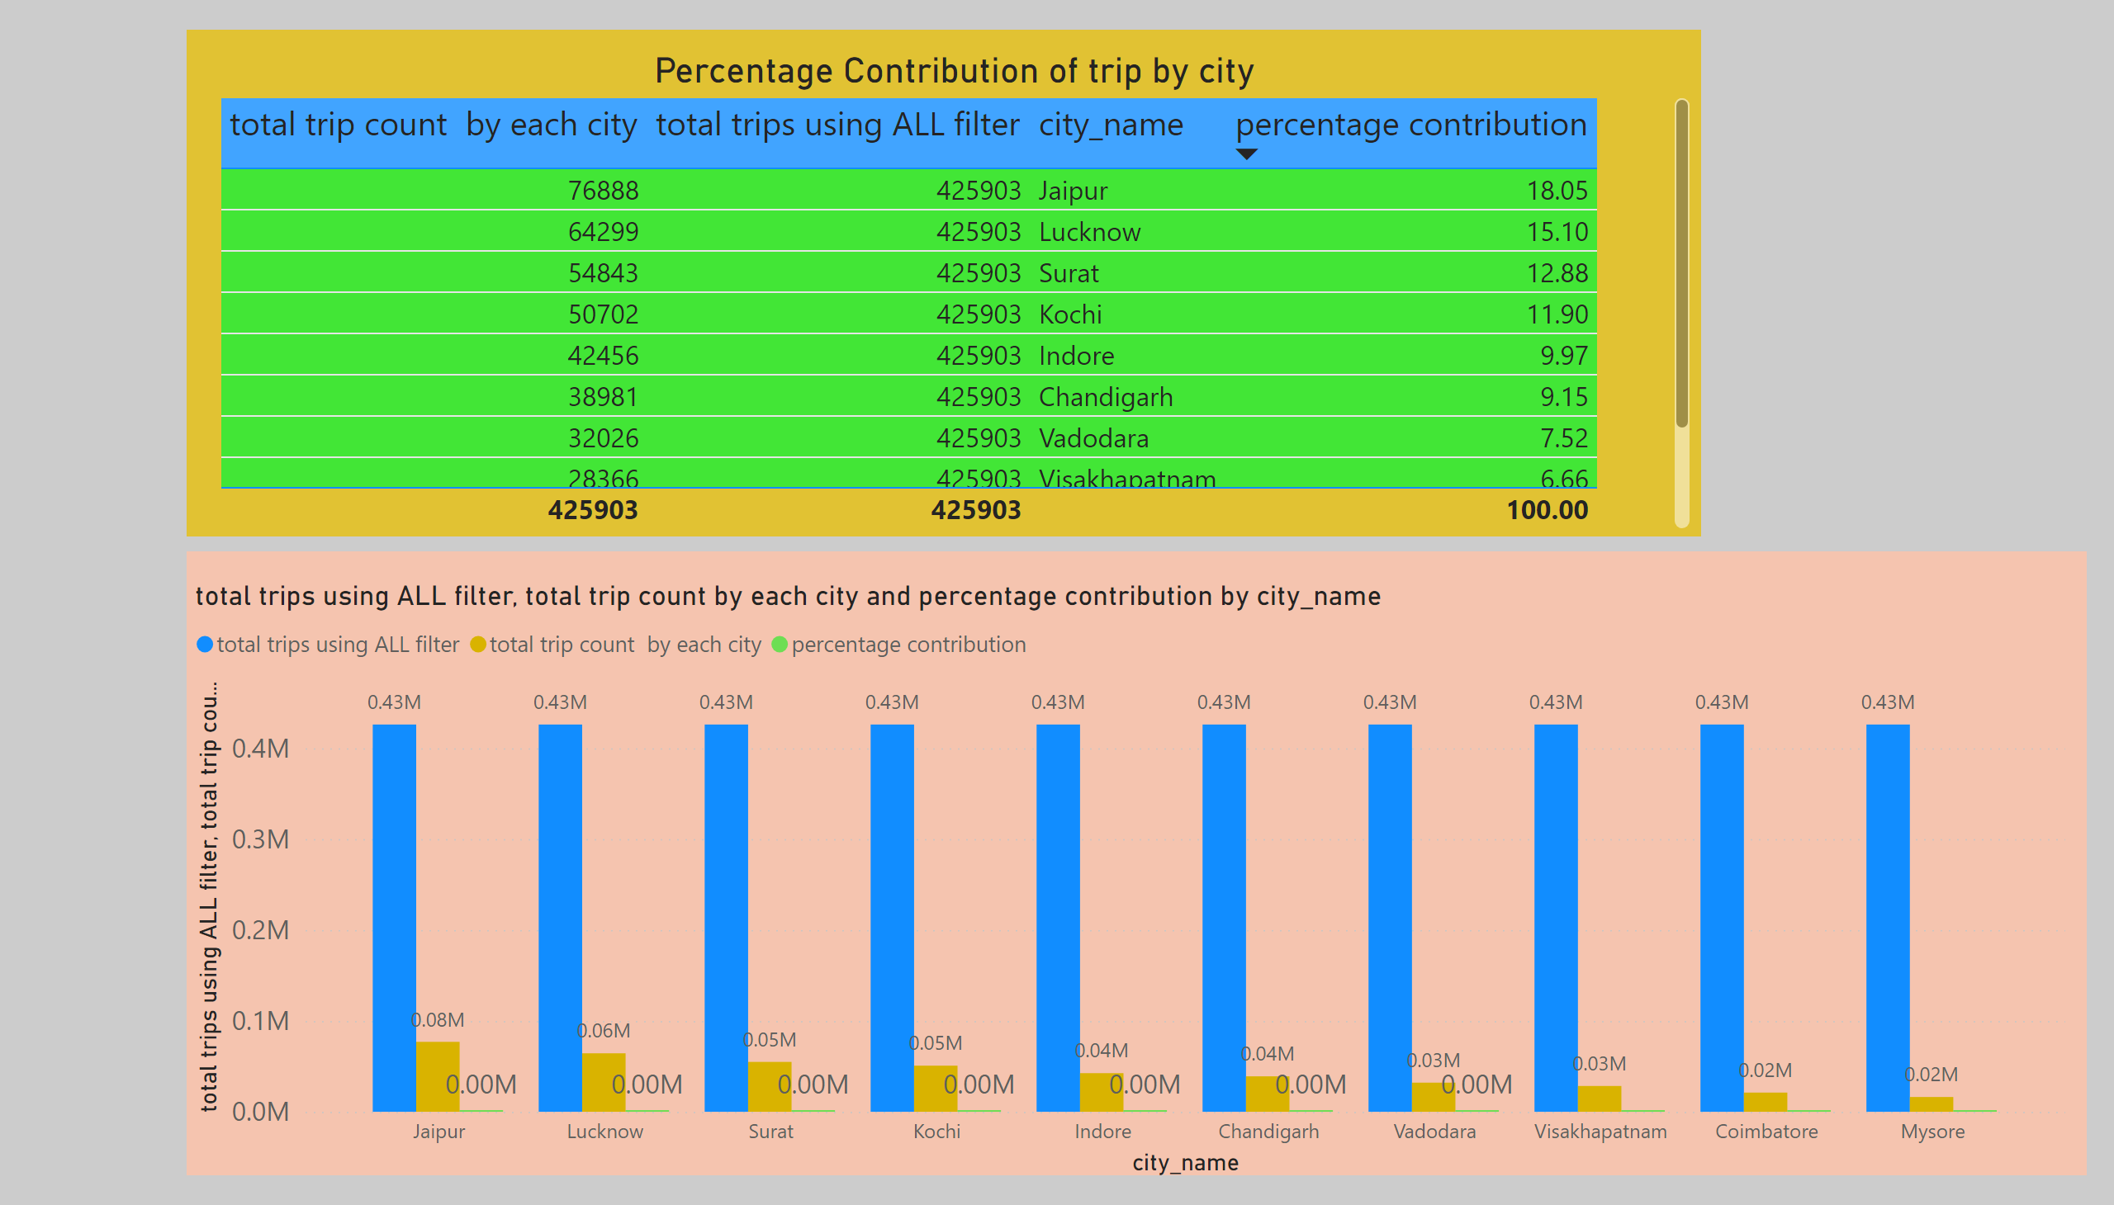
Trip percentage contribution of city
Notes:
Percentage Contribution of trip by city
No alt text provided
clusteredColumnChart
No alt text provided

Slide 7
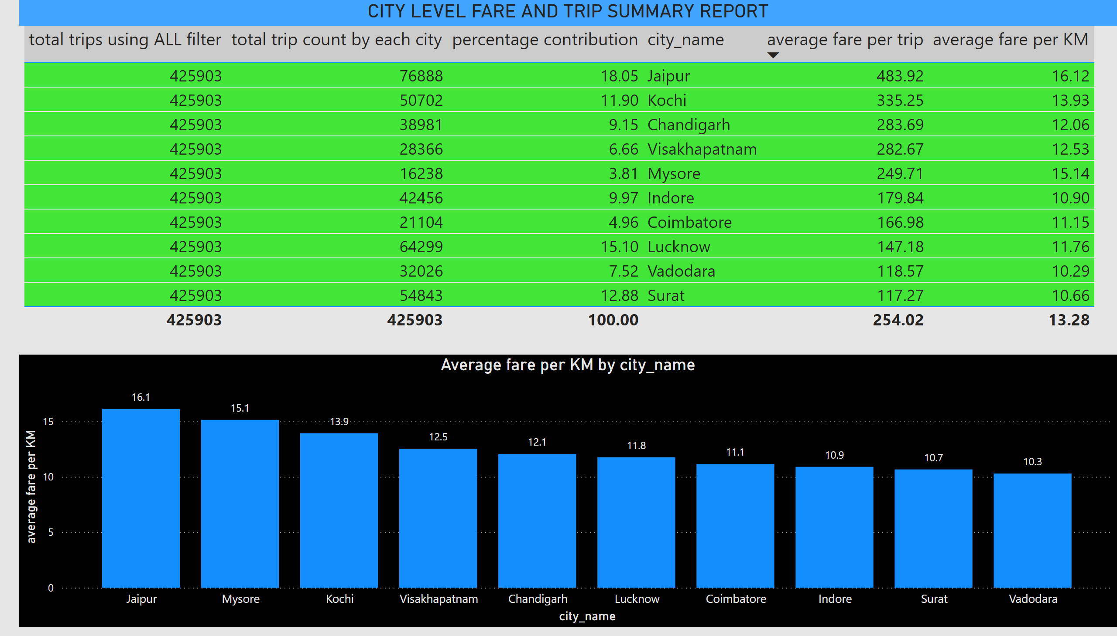
CITY-LEVEL FARE AND TRIP SUMMARY REPORT
Notes:
CITY LEVEL FARE AND TRIP SUMMARY REPORT
No alt text provided
Average fare per KM by city_name
No alt text provided

Slide 8
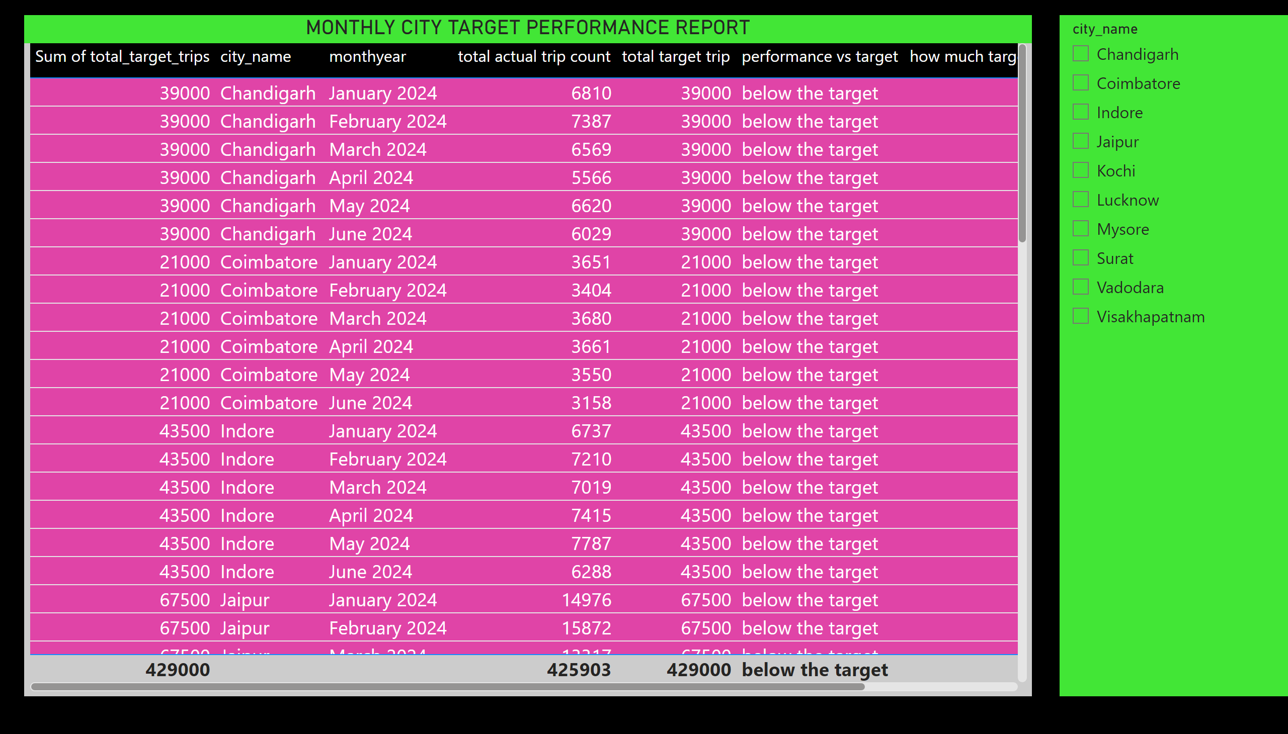
month-city level target performance report
Notes:
MONTHLY CITY TARGET PERFORMANCE REPORT
No alt text provided
slicer
No alt text provided

Slide 9

MONTHLY DEMAND BEHAVIOUR

Slide 10
TRIP TREND VS MONTH
For Chandigarh city ,Feb. month have highest demand and April month lowest .
For Jaipur city ,Feb. month have highest demand and June have lowest.
What It Tells
Seasonal Trends:
Cities with high trip counts in specific months may experience seasonal demand due to weather, festivals, or tourist activity.
Declines in certain months may reflect off-peak seasons or external factors like holidays or economic slowdowns.
City-specific Behavior:
Different cities might show unique demand patterns due to local events, holidays, or cultural preferences.
Market Dynamics:
Cities with steady demand indicate a strong, consistent customer base.
Fluctuating demand might suggest dependence on specific external factors like tourism or business events.
Operational Insights:
High-demand months might strain resources, indicating the need for additional drivers or vehicles.
Low-demand months might require cost-cutting measures to maintain profitability.

Slide 11
What Strategic Moves to Make
Dynamic Resource Allocation:
Deploy more vehicles and drivers in cities during high-demand months to meet customer needs.
Adjust fleet size and shift timings to optimize resources during off-peak months.
City-specific Strategies:
Customize strategies based on individual city trends:
Tourist Cities: Focus on advertising during peak tourist seasons.
Business Hubs: Ensure reliable service during weekdays or business hours.
Seasonal Cities: Plan ahead for weather-related demand surges (e.g., rains, snow).
Event-based Planning:
Partner with local events, festivals, or conferences to provide dedicated transport services during high-demand periods.
Advertise services tailored to event attendees or tourists.

Slide 12
EACH MONTH REVENUE FOR EACH CITY

Slide 13
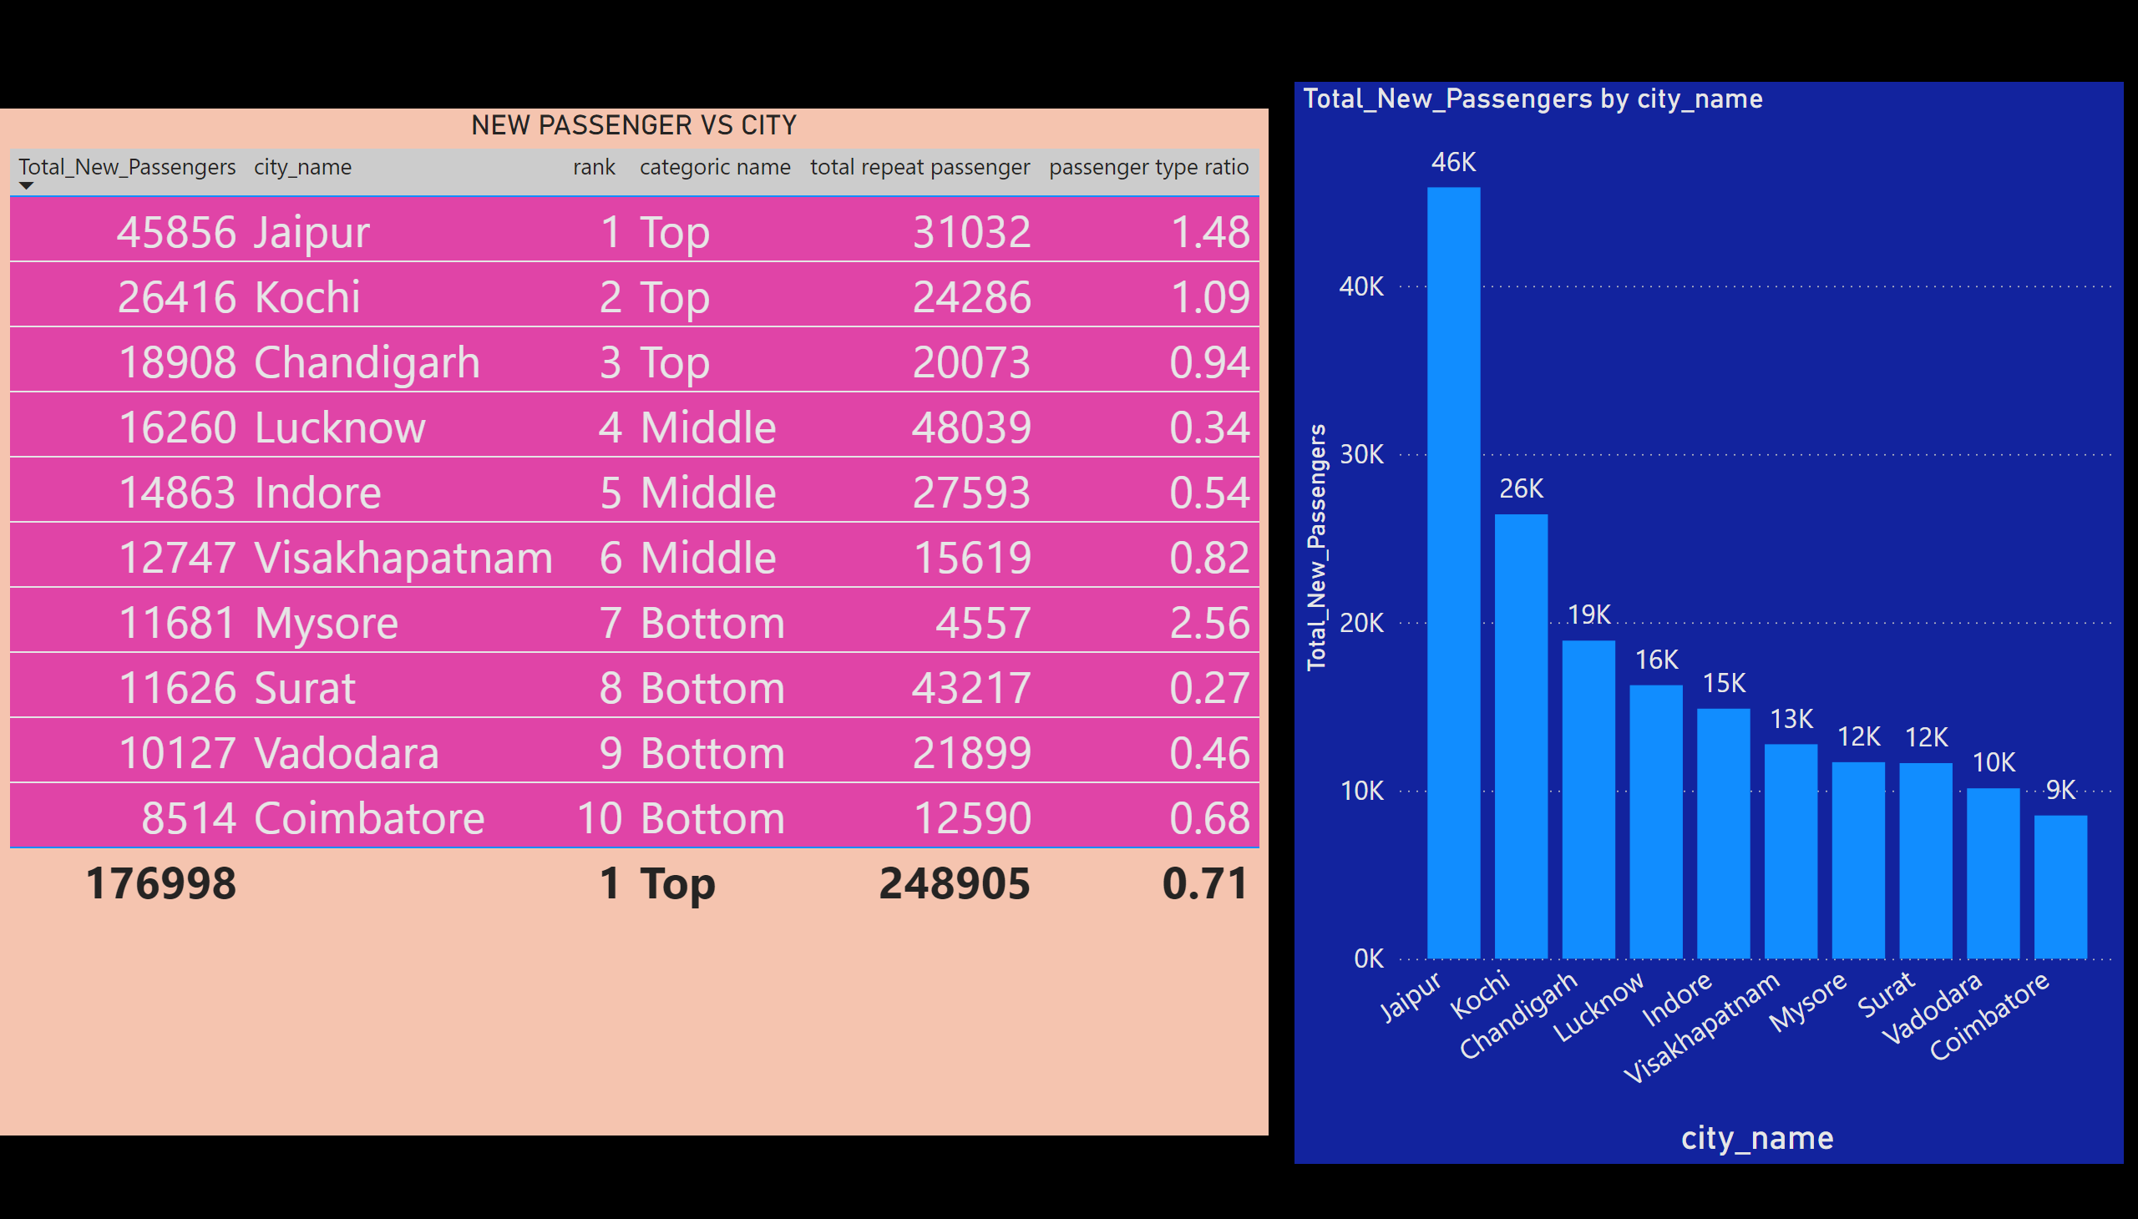
HIGHEST AND LOWEST NEW PASSENGER
Notes:
NEW PASSENGER VS CITY
No alt text provided
clusteredColumnChart
No alt text provided

Slide 14
Where passenger ratio >1 , those city have good flow of fresh customer -----due to demographic or tourism flow .
Jaipur and Kochi have >1 passenger ratio.

Slide 15
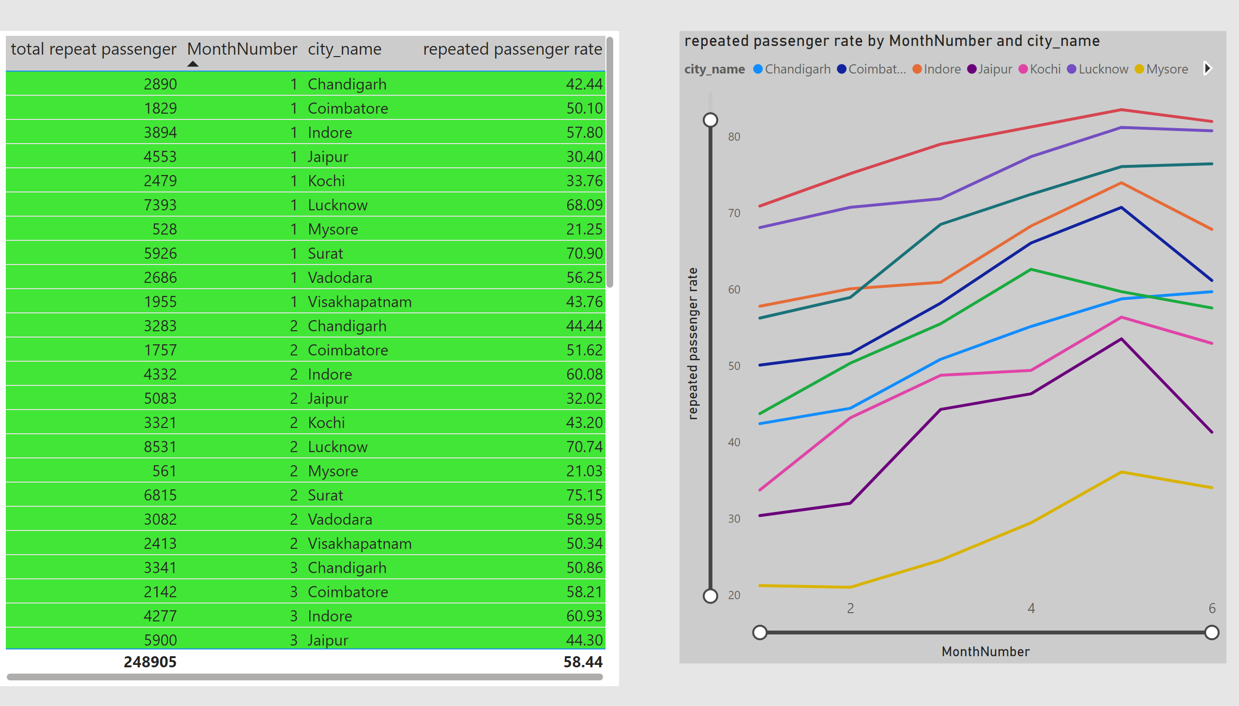
repeated passenger rate monthly for each city
Notes:
tableEx
No alt text provided
lineChart
No alt text provided

Slide 16
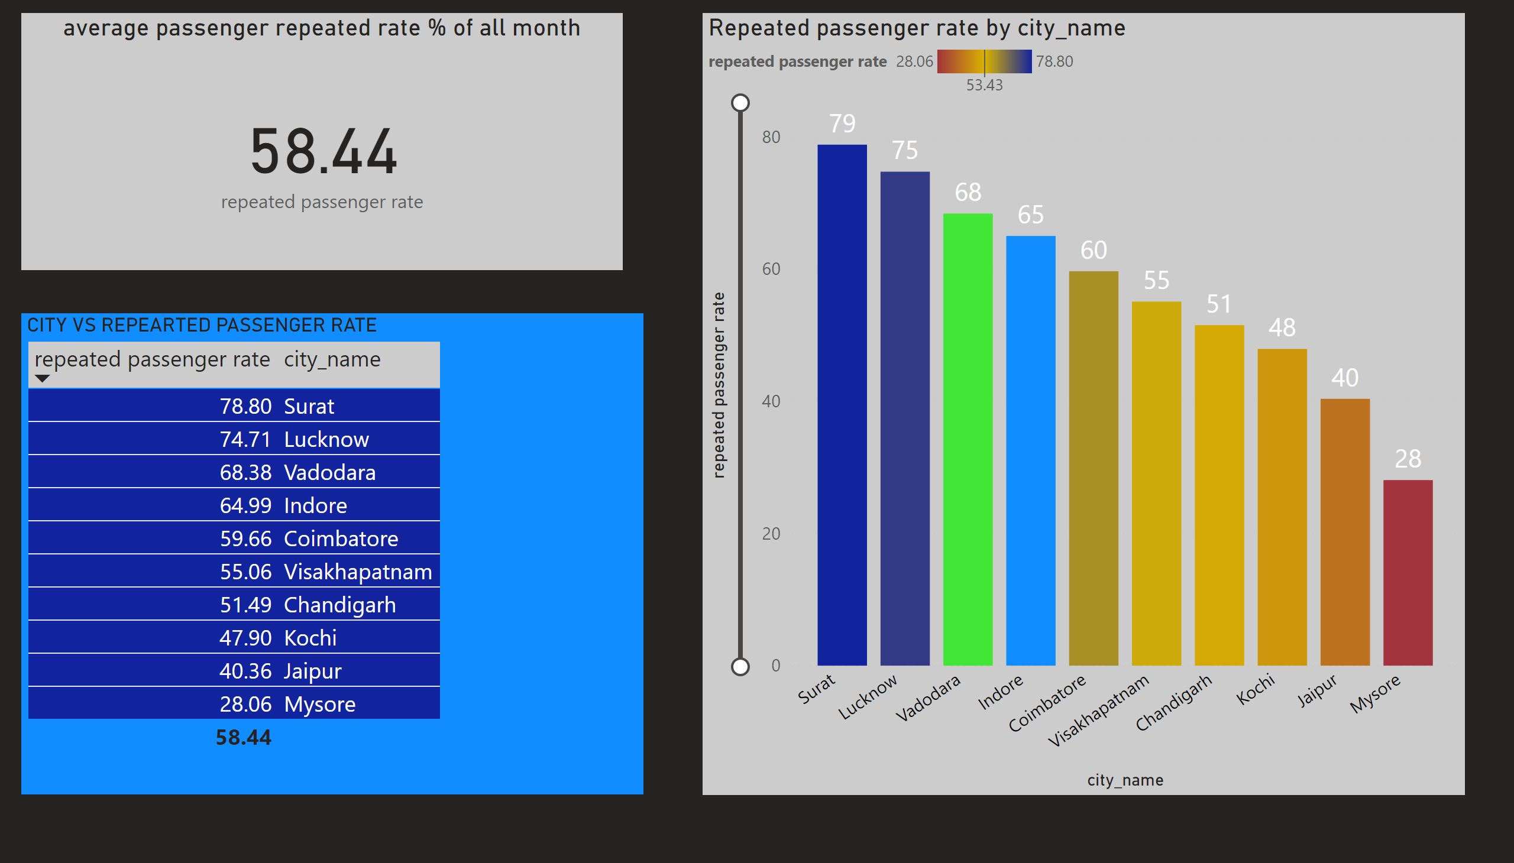
OVERALL REPEATED PASSENGER RATE FOR ALL MONTH
Notes:
CITY VS REPEARTED PASSENGER RATE
No alt text provided
Repeated passenger rate by city_name
No alt text provided
average passenger repeated rate % of all month
No alt text provided

Slide 17
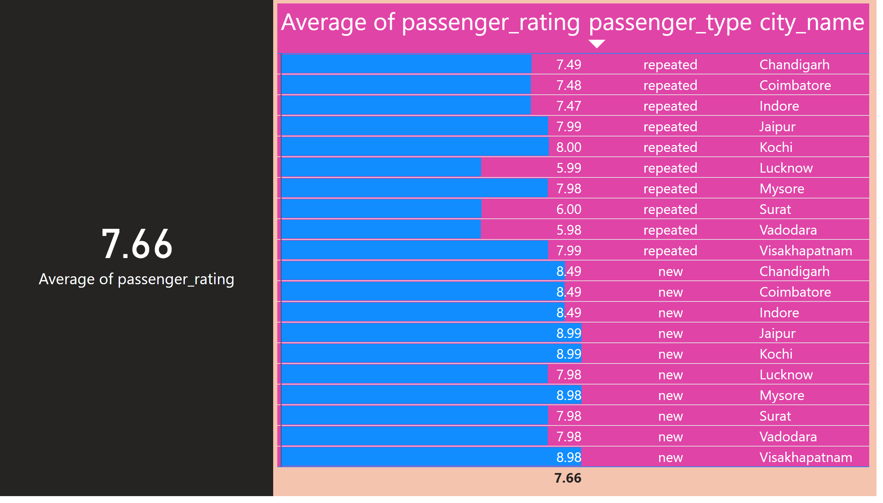
average passenger rating table by city name
Notes:
tableEx
No alt text provided
card
No alt text provided

Slide 18
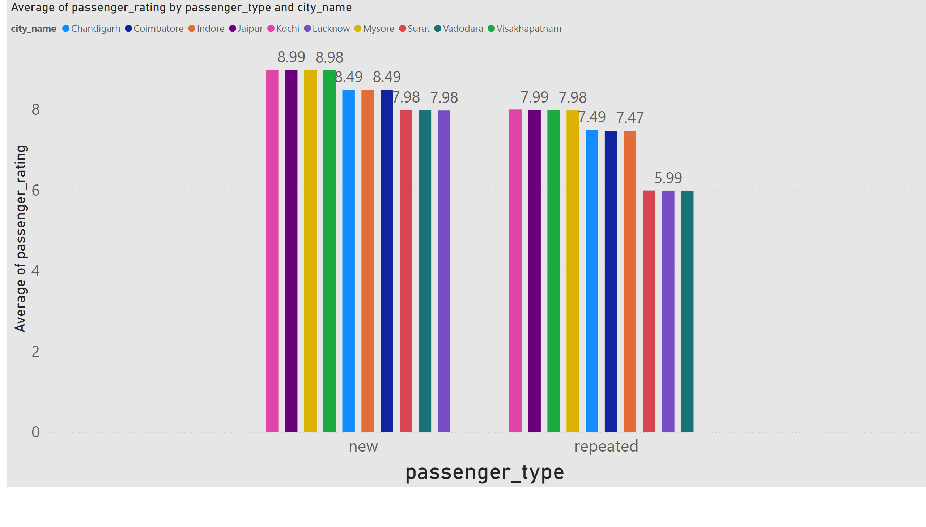
average passenger rating graph
Notes:
clusteredColumnChart
No alt text provided

Slide 19
MUTIPLE TRIPS DATA OF CITY

Slide 20
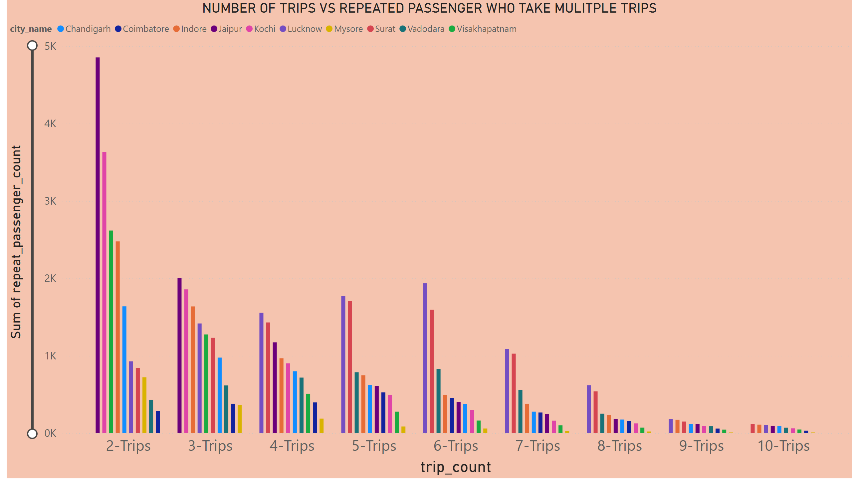
MUTIPLE TRPIS DATA OF CITY
Notes:
NUMBER OF TRIPS VS REPEATED PASSENGER WHO TAKE MULITPLE TRIPS
No alt text provided

